Slide 1
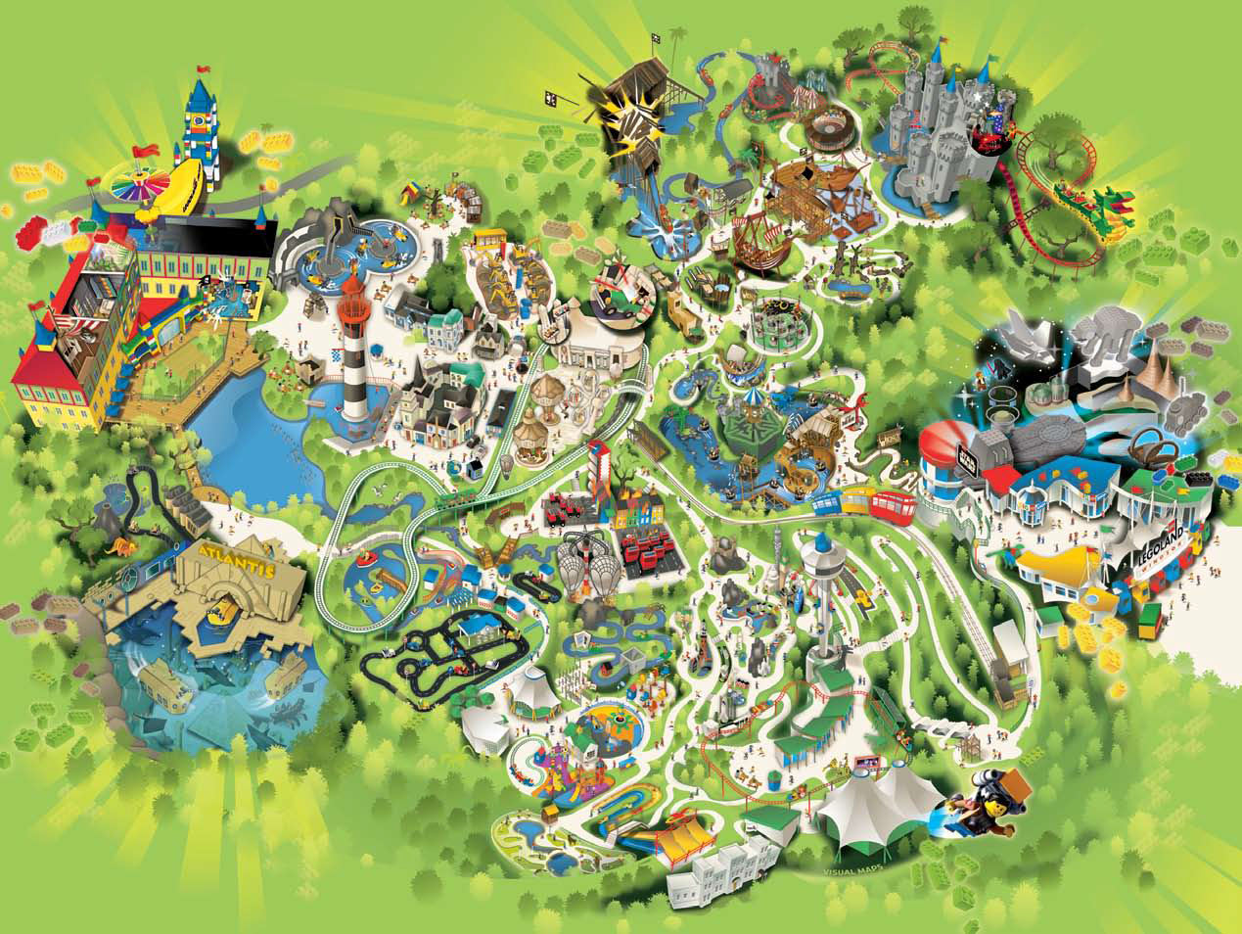
Pirate
Falls
SQUID
Surfer
Climbing
Wall
Jolly
Rocker
Digger
Challenge
Pizza&
Pasta
Mexican
Coffee
Ices
Laser Raider /
Scarab-bouncer
Burger
Longboat
Invader
Orient
Expedition
Thunder
Blazer
Aero
Nomad
Desert
Chase
Loki’s
Labyrinth
Dino
Safari
Baguette
Fire
Academy
Atlantis
Boating
School
L-Drivers
Balloon
Academy
Driving
School
Minilan
DUPLO
Theatre
DUPLO
Airport
Family
Buffet
Fried
Chicken
DUPLO
Train

Slide 2
Dragon’s
Apprentice
Knight’s
Quest
Dragon
Ices
Rotisserie
Pirate
Falls
BBQ
Pirate
Training
Ground
Jolly
Rocker
Digger
Challenge
Enchanted
Forest
BBQ
Spinning
Spider
Laser Raider /
Scarab-bouncer
Longboat
Invader
Thunder
Blazer
Aero
Nomad
Loki’s
Labyrinth
Viking
Splash
Desert
Chase
Star Wars
Fire
Academy
Cafe
L-Drivers
Balloon
Academy
Miniland
Space
Tower
Pizza
Hill
Train
DUPLO
Theatre
DUPLO
Airport
Hero Factory
Build&Test
Sky
Rider
Family
Buffet
Ices
DUPLO
Train
Mindstorms
Exploratorium
Imagination
Theatre

